Slide 1
Lecture 03 Data Representation II COMP1411: Introduction to Computer Systems
Dr. Mingsong LYU (呂鳴松)
Department of Computing,
The Hong Kong Polytechnic University
Spring 2023
Acknowledgement: These slides are based on the textbook (Computer Systems: A Programmer’s Perspective) and its slides.
These slides are only intended to use internally. Do not publish it anywhere without permission.

Slide 2
Overview
Getting familiar with fractional binary numbers
IEEE floating point standard
Examples and properties
Computation over floating point numbers

Slide 3
Fractional binary numbers
Fractional decimal numbers
11.625₁₀ = 1 * 10¹ + 1 * 10⁰ + 6 * 10⁻¹ + 2*10⁻² + 5*10⁻³
Precision limitation: 10⁻³ (0.001)
Fractional binary numbers
1011.101₂ = 1 * 2³ + 0 * 2² + 1 * 2¹ + 1 * 2⁰ + 1 * 2⁻¹ + 0 * 2⁻² + 1 * 2⁻³
Precision: 2⁻³ (1/8)
Binary | Decimal
0.001 | 0.125
0.010 | 0.25
0.011 | 0.375
0.100 | 0.5
0.101 | 0.625
0.110 | 0.75
0.111 | 0.875

Slide 4
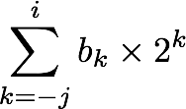
Fractional binary numbers
2^{i}
2^{i-1}
4 = 2²
2 = 2¹
1 = 2⁰
• • •
bi | bi-1 | ••• | b2 | b1 | b0 | b-1 | b-2 | b-3 | ••• | b-j
2⁻¹ = 1/2
2⁻² = 1/4
2⁻³ = 1/8
2^{-j}
• • •

Slide 5
Representable numbers
Limitation #1
Can only exactly represent numbers of the form x/2^{k}
Values that cannot be exactly represented:
1/3 0.0101010101[01]…₂
1/5 0.001100110011[0011]…₂
1/10 0.0001100110011[0011]…₂
Limitation #2
Given a fixed number of bits, limited range of numbers
More integer bits, or more fraction bits?
Larger value, or better precision?
We are running out of bits …
Point here?
More precise fraction
Point here?
Larger value

Slide 6
Overview
Get familiar with fractional binary numbers
IEEE floating point standard
Examples and properties
Computation over floating point numbers

Slide 7
IEEE Floating Point
IEEE Standard 754
Many machines were having different floating point encodings, hard to exchange information
In 1985, IEEE established a uniform standard for floating point arithmetic
Nowadays, supported by all major CPUs
Driven by numerical concerns
Nice standards for rounding, overflow, underflow
Hard to make fast in hardware
Numerical analysts predominated over hardware designers in defining standard

Slide 8
Floating Point Representation
Numerical form
Sign bit s determines whether number is negative or positive
Significand M is normally a fractional value in range [1.0,2.0).
Exponent E weights value by power of two
Encoding
Most Significant Bit s is sign bit s
exp field encodes E (but is not equal to E)
frac field encodes M (but is not equal to M)
s
exp
frac
float
31
30
23
22
0
double
63
62
52
51
0
v = (–1)^{s} M 2E

Slide 9
Normalized values - Definition
When: exp ≠ 000…0 and exp ≠ 111…1
E = exp – Bias
exp: unsigned value read from the exp field
Bias = 2^{k-1} -1, where k is the number of bits for exp
E.g., single precision, k = 8, exp = 1 ~254, E = -126 ~ 127
M = 1.xxx…x₂ (with implied leading 1)
xxx…x: bits from the frac field
Minimum when frac = 000…0 (M = 1.0)
Maximum when frac = 111…1 (M = 2.0 - ε)
(Get extra leading bit for free)
s
exp
frac
v = (–1)^{s} M 2E

Slide 10
Normalized values - Example
Compute the decimal value of this 32-bit floating point number
0100 0110 0110 1101 1011 0100 0000 0000
k = 8
S = 0
Significand
frac = 11011011011010000000000₂
M = 1.1101101101101₂
Exponent
Exp = 10001100₂ = 140
Bias = 2⁷ – 1 = 127
E = Exp – Bias = 13
0
10001100
11011011011010000000000
v = (–1)^{s} M 2E

Slide 11
Denormalized values
When: exp = 000…0
E = 1 – Bias (NOT 0 – Bias)
M = 0.xxx…x₂ (with implied leading 0)
xxx…x: bits from the frac field
Cases
exp = 000…0, frac = 000..0 → zero value
Note that s = 0/1, possitive/negative zero
exp = 000…0, frac ≠ 000…0 → numbers closest to 0.0
s
0000000…0
frac
v = (–1)^{s} M 2E

Slide 12
Special values
When: exp = 111…1
Case: exp = 111…1, frac = 000…0
Represents value ∞ (infinity)
Operation that overflows
e.g., the result of 1.0/0.0
Case: exp = 111…1, frac ≠ 000…0
Not-a-Number (NaN)
Represents case when no numeric value can be determined
E.g., the result of sqrt(-1), ∞ - ∞, ∞ × 0
s
1111111…1
frac
v = (–1)^{s} M 2E

Slide 13
A miniature floating point example
An 8-bits floating point representation
s
4-bits exp
3-bits frac
The smallest non-negative normalized number?
The largest non-negative normalized number?
The smallest non-negative denorm number?
The largest non-negative denorm number?

Slide 14
A miniature floating point example
An 8-bits floating point representation
s
4-bits exp
3-bits frac
s exp frac E Value
0 0000 000 -6 0
0 0000 001 -6 1/8*1/64 = 1/512
0 0000 010 -6 2/8*1/64 = 2/512
…
0 0000 110 -6 6/8*1/64 = 6/512
0 0000 111 -6 7/8*1/64 = 7/512
0 0001 000 -6 8/8*1/64 = 8/512
0 0001 001 -6 9/8*1/64 = 9/512
…
0 0110 110 -1 14/8*1/2 = 14/16
0 0110 111 -1 15/8*1/2 = 15/16
0 0111 000 0 8/8*1 = 1
0 0111 001 0 9/8*1 = 9/8
0 0111 010 0 10/8*1 = 10/8
…
0 1110 110 7 14/8*128 = 224
0 1110 111 7 15/8*128 = 240
0 1111 000 n/a inf
closest to zero
Denormalized
numbers
largest denorm
smallest norm
Normalized
numbers
closest to 1 below
closest to 1 above
largest norm
Special values

Slide 15
Visualizing floating point encodings
Only representing discrete numbers in a range
Variable precision: higher as the value is closer to zero
Smooth transition at the boundary of denorm and normalized
−∞
+∞
−Normalized
−Denorm
+Denorm
+Normalized
NaN
NaN
−0
+0

Slide 16
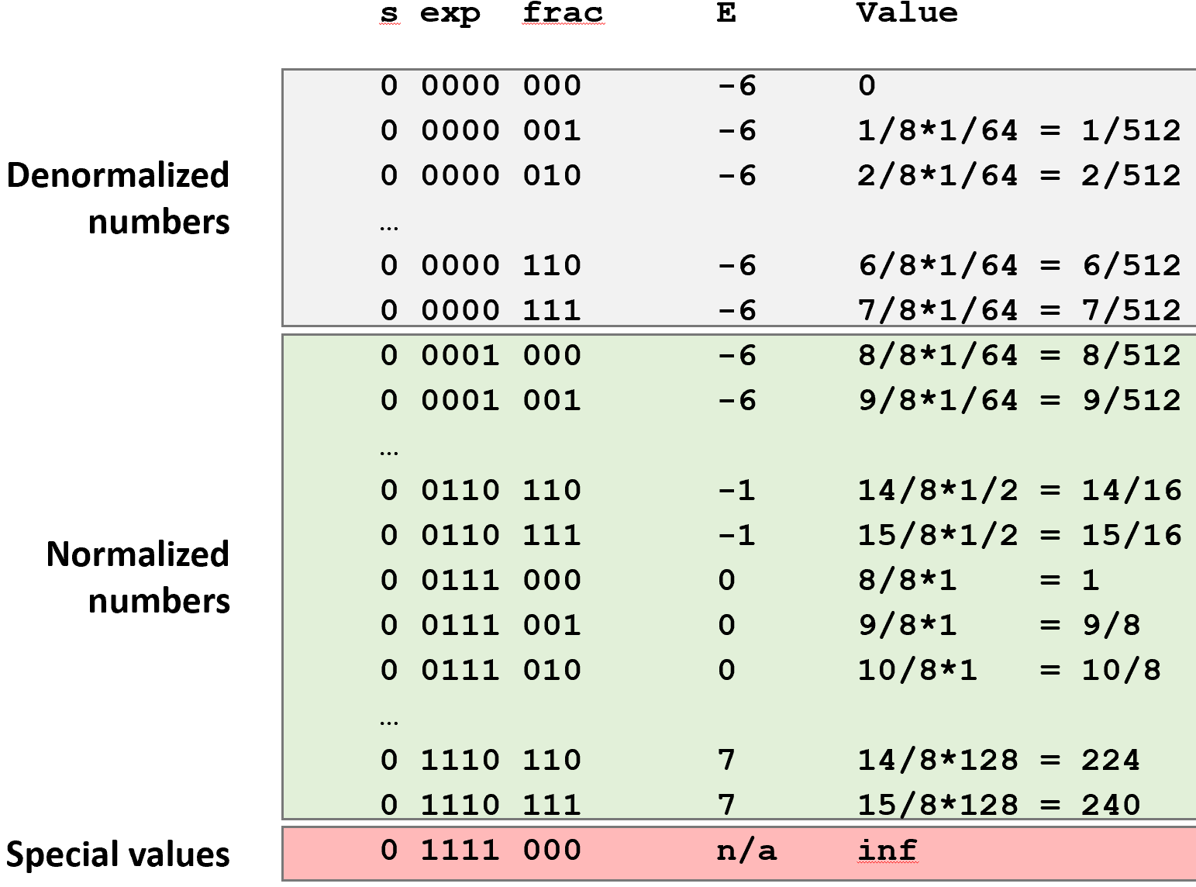
Properties
Floating point zero same as integer zero
All bits are 0
Can (almost) use unsigned integer comparison
Must first compare sign bits
Must consider -0 = 0
NaNs problematic
Will be greater than any other values
What should the comparison yield?
Otherwise OK
Denorm vs. normalized
Normalized vs. infinity

Slide 17
Encoding an integer into the floating point format
Steps
Normalize to have leading 1
Round to fit within fraction
Post-normalize to deal with effects of rounding
Case study
s
4-bits exp
3-bits frac
Value | Binary
128 | 10000000
15 | 00001101
17 | 00010001
19 | 00010011
138 | 10001010
63 | 00111111

Slide 18
Normalize
Requirement
Set binary point in the form 1.xxx…x
Decrement exponent as you shift the point to the left
s
4-bits exp
3-bits frac
Value | Binary | Fraction | E
128 | 10000000 | 1.0000000 | 7
15 | 00001101 | 1.1010000 | 3
17 | 00010001 | 1.0001000 | 4
19 | 00010011 | 1.0011000 | 4
138 | 10001010 | 1.0001010 | 7
63 | 00111111 | 1.1111100 | 5

Slide 19
Rounding
s
4-bits exp
3-bits frac
Round up conditions
Round = 1, sticky = 1 → > 0.5
Round = 1, sticky = 0 → round to even, to make G an even number
1.BBGRXXX
Guard bit: LSB of result
Round bit: 1st bit removed
Sticky bit: OR of remaining bits
Value | Fraction | GRS | Incr? | Rounded
128 | 1.0000000 | 000 | NO | 1.000
15 | 1.1010000 | 100 | NO | 1.101
17 | 1.0001000 | 010 | NO | 1.000
19 | 1.0011000 | 110 | YES | 1.010
138 | 1.0001010 | 011 | YES | 1.001
63 | 1.1111100 | 111 | YES | 10.000

Slide 20
Post-normalize
Issue
Rounding may have caused overflow
Handle by shifting right once & incrementing exponent
Value | Rounded | exp | Adjust | Result
128 | 1.000 | 7 |  | 128
15 | 1.101 | 3 |  | 15
17 | 1.000 | 4 |  | 16
19 | 1.010 | 4 |  | 20
138 | 1.001 | 7 |  | 144
63 | 10.000 | 5 | 1.000/6 | 64

Slide 21
Overview
Background: fractional binary numbers
IEEE floating point standard: definition
Examples and properties
Computation over floating point numbers

Slide 22
Floating point multiplication
(–1)^{s1} M1 2^{E1} x (–1)^{s2} M2 2^{E2}
Exact Result: (–1)^{s} M 2E
Sign s: s1 ^ s2
Significand M: M1 x M2
Exponent E: E1 + E2
Fixing
Round M to fit frac precision
If M ≥ 2, shift M right, increment E
If E out of range, overflow
Implementation
The biggest task is multiplying significands
s1
exp1
frac1
s2
exp2
frac2

Slide 23
Mathematical properties of FP Mult
For the following questions, YES or NO?
Multiplication Commutative (a*b = b*a)?
Multiplication Associative ((a*b)*c = a*(b*c))?
Possibility of overflow, inexactness of rounding
Eg: (1e20*1e20)*1e-20= inf, 1e20*(1e20*1e-20)= 1e20
1 * a = a?
Multiplication distributes over addition (a*(b+c) = a*b + a*c)?
Possibility of overflow, inexactness of rounding
1e20*(1e20-1e20)= 0.0, 1e20*1e20 – 1e20*1e20 = NaN

Slide 24
Floating point addition
(–1)^{s1} M1 2^{E1} + (-1)^{s2} M2 2^{E2}
Assume E1 > E2
Exact Result: (–1)^{s} M 2E
Sign s, significand M:
Result of signed align & add
Exponent E: E2
Fixing
If M ≥ 2, shift M right, increment E
if M < 1, shift M left k positions, decrement E by k
Overflow if E out of range
Round M to fit frac precision
Get binary points lined up
E1–E2
(–1)^{s1} M1
+
(–1)^{s2} M2
(–1)^{s} M

Slide 25
Mathematical properties of FP addition
For the following questions, YES or NO?
Commutative (a+b = b+a)?
Associative ((a+b)+c = a+(b+c))??
Overflow and rounding
(3.14 + 1e20) – 1e20 = 0.0
3.14 + (1e20 – 1e20) = 3.14
0 is additive identity?
Every element (x) has an additive inverse (exists x’, so that x+x’=0)?
−∞
+∞
−Normalized
−Denorm
+Denorm
+Normalized
NaN
NaN
−0
+0

Slide 26
Thank You

